Slide 1
Reimagining Print in a Digital World
Sarmad Ali
Managing Director
Jang Media Group
MARCON January 10, 2019
Notes:
Asalamulalkum and Good Afternoon.
The theme of this year’s MARCON is Reimagining marketing in the Digital World. But I am here to talk about something that is over 400 years old and will continue to thrive in not only this age of Digitalisation but whatever-comes-next-isation…. The good old newspaper….

Slide 2
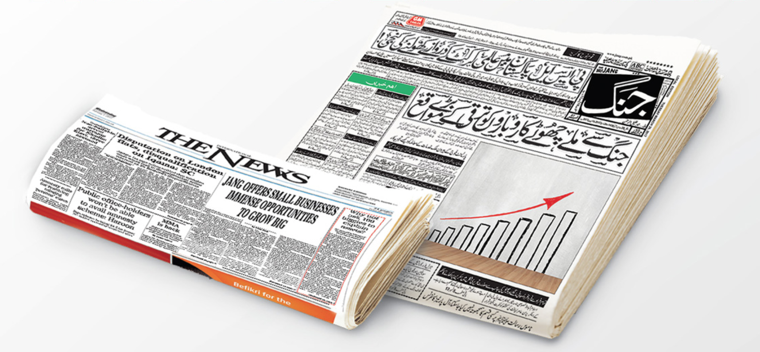
Window
of
Pain
Notes:
I have been a print man all my life. I love and breathe newspapers. The feel and smell of ink and paper turns me on even today. But in this ever evolving media landscape, the key challenge for the newspapers has been how to seamlessly connect the offline experience with the online.The window of pain for newspapers in our part of the world has been the fact that the younger audiences are getting disconnected with the offline print product as they do not find newspapers sexy. This is the primary crisis in the print ecosystem. We need to find opportunity in this crisis in order to become relevant to the millenials and Gen Z by developing innovative print products that can bring them back to our fold and that recreate something that has been like a habit for generations.
So ladies & gentlemen, what can we do to make newspaper sexier??

Slide 3
QR: Jang Classifieds
AR: Integrating newspaper headlines with TV headlines through Augmented Reality
Jang VR: Creating Virtual Reality through newspapers
Jang
Innovations
Notes:
Today, I will be sharing with you 3 specific initiatives that we have taken to integrate offline with online. By introducing these innovations, we have tried to connect with the younger audiences that was losing touch with printed newspaper. These initiatives have proved to be Game Changers not only for us but for the newspapers in Pakistan.

Slide 4
Jang
Classifieds
Jang newspaper is the largest classified platform in Pakistan, with annual revenues exceeding Rs. 600 million (5 Million USD)
The important Classified categories range from automobiles, real estate, education, matrimonials and Jobs
Jang Classified, a 24 page special section, is published every Sunday with the Jang newspaper from 7 of Pakistan’s top cities, representing 70% of the urban consumer purchasing power in Pakistan
Notes:
Jang newspaper is the largest classified platform in Pakistan, with annual revenues exceeding Rs. 600 million (5 Million USD)
The important Classified categories range from automobiles, real estate, education, matrimonials and Jobs
Jang Classified, a 24 page special section, is published every Sunday with the Jang newspaper from 5 of Pakistan’s top cities, representing 70% of the urban consumer purchasing power in Pakistan

Slide 5
Jang Classifieds
Challenges
The advent of Online Classified portals has had an adverse impact on the print classifieds
Our Classified revenues had declined in 2015 by 17% with a volume decline of almost 20%
The biggest challenge was Free vs Paid and dynamic, interactive Color visuals vs plain B/W static Text
Notes:
The advent of Online Classified portals has had an adverse impact on the print classifieds
Our Classified revenues had declined in 2015 by 17% with a volume decline of almost 20%
The biggest challenge was Free vs Paid and dynamic, interactive Color visuals vs plain B/W static Text.
Customers were shifting to posting free ads online on different classified portals. Particularly, in the Automobile and Real Estate categories

Slide 6
Jang Classifieds
– QR Code
We introduced QR codes in key categories of real estate and automobiles to make the consumer experience more dynamic and vibrant
And to deliver value to the consumer by adding video/audio and photo features to the existing print product
Notes:
We introduced QR codes in key categories of real estate and automobiles to make the consumer experience more dynamic and vibrant
And to deliver value to the consumer by adding video/audio and photo features to the existing print product
Online portals only had still images, with no audio/visual element while Jang Classified supported the additional audio/video features

Slide 7
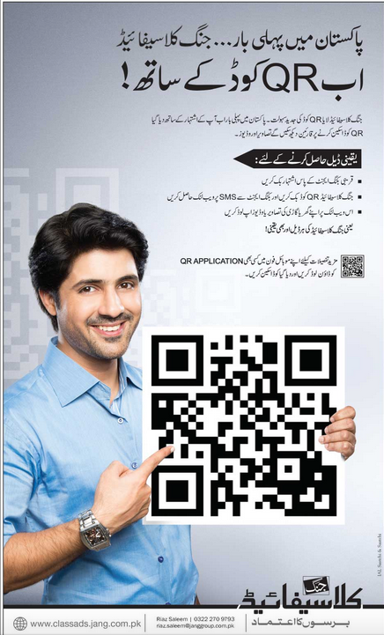
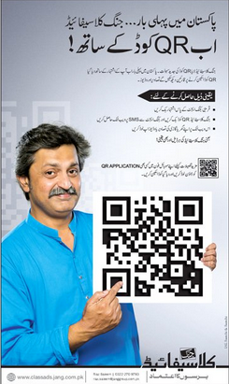
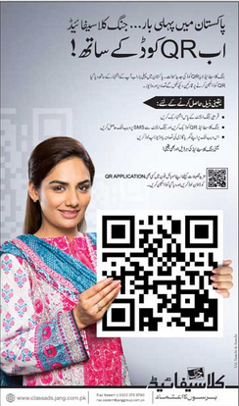
Notes:
With Jang QR codes all you have to do is to upload videos or photos of your home or car or whatever, send it to us through Whatsapp and email, to enable us to generate QR code in the print product.

Slide 8
Jang Classifieds:
Results
The revenue has gone up 30% since 2016, when QR code was launched.
Jang Classified volume has gone up by 27%.
Notes:
The results have been Impressive for us.
The revenue has gone up 30% since 2016, when QR code was launched.
Jang Classified volume has gone up by 27%.

Slide 9
Jang Real
Notes:
From QR codes we move on to another innovation - Augmented Reality

Slide 10
Jang Real
Augmented Reality is not a very common concept in Pakistan. Jang developed its own AR App - Jang Real - towards the end of 2016.
This is the first time any media house has made use of AR in Pakistan.
Jang Real adds value to the news by augmentising content as well as monetising it.
Notes:
Augmented Reality is not a very common concept in Pakistan. Jang developed its own AR App - Jang Real - towards the end of 2016.
This is the first time any media house has made use of AR in Pakistan.
Jang Real adds value to the news by augmentising content as well as monetising it.

Slide 11
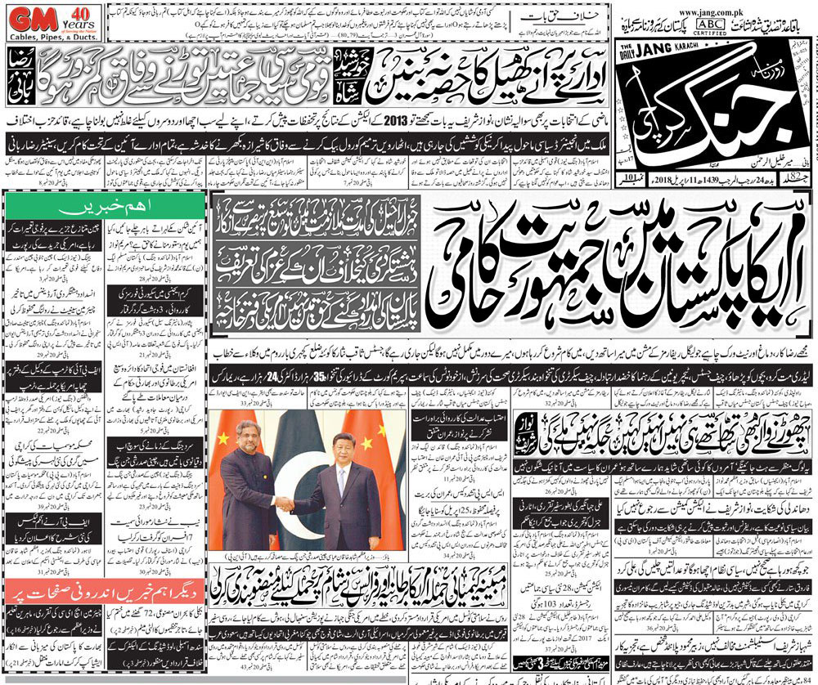
Newspaper
goes
Live
By scanning the news with your Jang real App, you can watch the news from Geo news channel.
Notes:
All you have to do is scan Jang headlines and you go to the footage of the same news headline on our news channel - Geo News. Thus by integrating offline with online, we monetised the headline by getting sponsors for it.

Slide 12
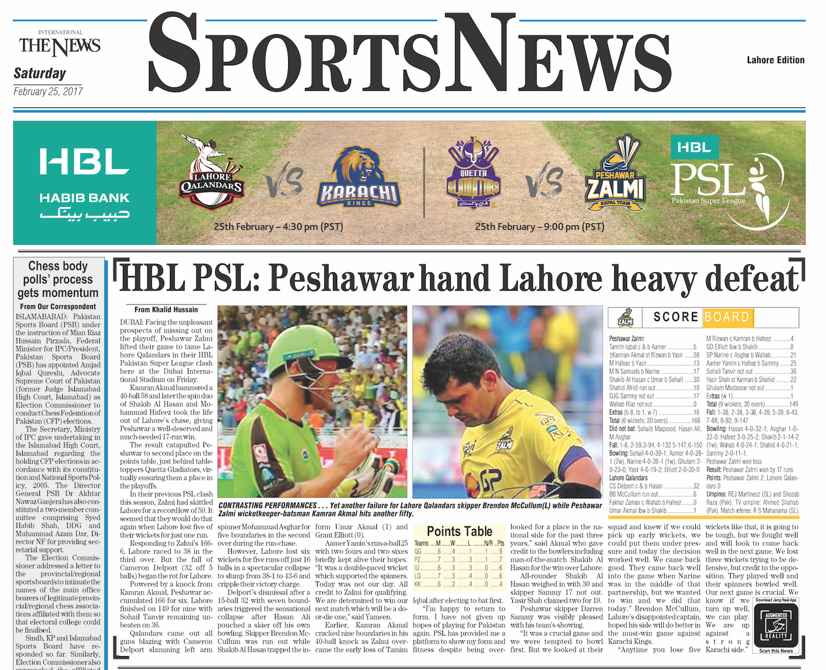
Monetizing
Jang Real

Slide 13
Jang Real:
Results
App downloads – 110,347
Scans/day – 75,530
Notes:
Launched in 2016, Jang Real till now has…

Slide 14
Jang Virtual Reality
Notes:
And the third innovation is Virtual Reality

Slide 15
Jang VR
We introduced Virtual Reality in mid 2017.
2017 marked the 70 years of Pakistan and also the 70 years of our flagship brand, Jang newspaper's publication in Pakistan.
We gave our readers a virtual gallery of our front pages from these 70 years.
Notes:
We introduced Virtual Reality in mid 2017.
2017 marked the 70 years of Pakistan and also the 70 years of our flagship brand, Jang newspaper's publication in Pakistan.
We gave our readers a virtual gallery of our front pages from these 70 years.

Slide 16
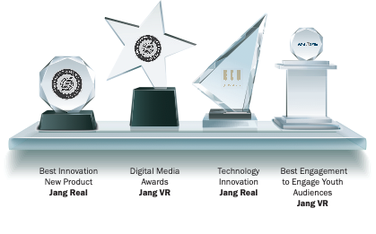
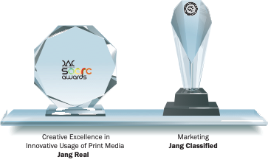
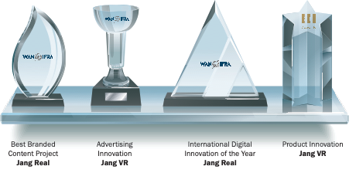
Recognition
Notes:
Our innovations have been recognized and acclaimed worldwide…. In the last 2 yearlong we have received 10 global awards for our efforts reunite print in a digitalized world

Slide 17
So
who says
newspapers are dying??
Notes:
So ladies and gentlemen who says newspapers are dying in the digitalized world. Well, Fawad Chaudhry for one…. But We dont! The key challenge for us lies in recreating habit and loyalty that has been the hallmark of newspapers for decades through innovations that connects the offline with the online and make newspapers sexier and relevant to the young pakistan.
So pick up a copy of your favorite newspaper, that is Jang and experience these innovations NOW.

Slide 18
Thank You!
+92 321 8295005
Sarmad.ali@janggroup.com.pk
jang.solutions
Notes:
For any information on how to augmnentise out virtualize your advertising in
Jang you may contact me or my team….thank you ….

