Slide 1







BUILDING PURPOSEFUL BRANDS IN A CONNECTED WORLD.
Asad ur Rehman
Director Media & Digital Transformation, Unilever North Africa & Middle East
@asadchawla
Notes:
20min preso, 10min Q&A
Good morning
Introduction
Big Data context
Crafting brands spiel

Slide 2





























Notes:
Most of you will be familiar with Unilever, but just in case, here’s just a snapshot of some of our over 400 brands. We are a mass market consumer goods company serving 2bn people a day in 190 countries. We are the largest tea, ice cream, soap and deodorant company in the world.
Recently we have also been building a prestige beauty business with the acquisitions of Ren, Dermalogica, Liz Somerville and Murad, Dollar Shave Club, Seventh Generation, making us a strong player in a market that is growing at a really fast pace.

Slide 3
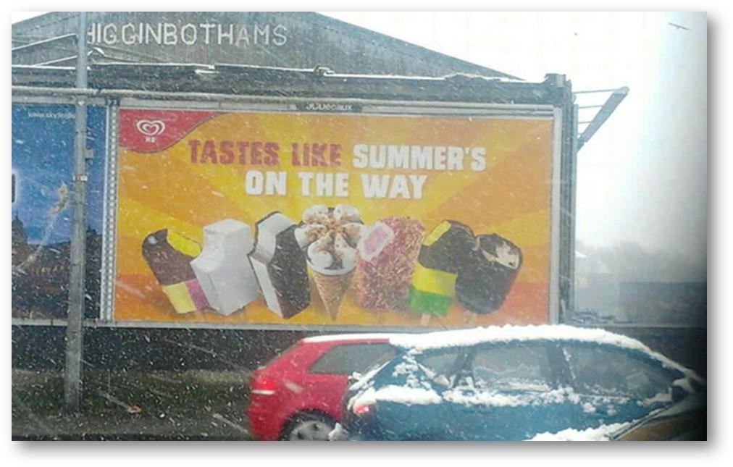
Notes:
So this is the old world. Where you knew you had put a billboard up for a campaign, but you didn’t know if it has been taken down. You also didn’t know if any of the environmental contexts had made that message redundant, or even negative in certain cases. As in the case of this particular image.

Slide 4
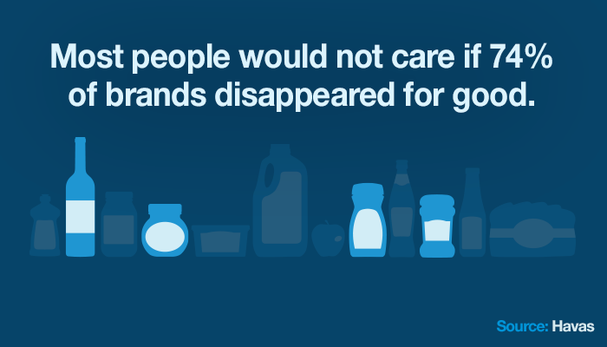
Notes:
As if all of this was not enough, we also have another issue we are facing! This fact in my opinion has less to do with consumer’s cynicism of advertising and brands, and more with our ability to stand out and shine as a brand. Nonetheless, this is a very alarming figure.

Slide 5
JUST A DECADE AGO…
Notes:
As if all of this was not enough, we also have another issue we are facing! This fact in my opinion has less to do with consumer’s cynicism of advertising and brands, and more with our ability to stand out and shine as a brand. Nonetheless, this is a very alarming figure.

Slide 6
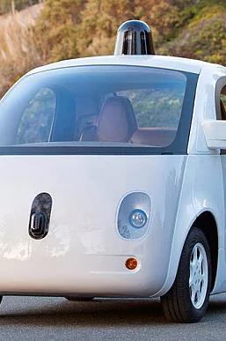
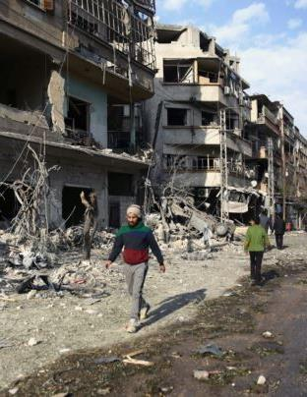
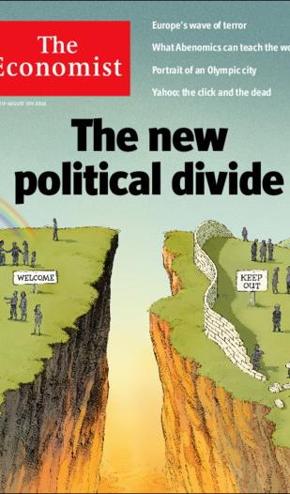
THE BEST OF TIMES, THE WORST OF TIMES.

Slide 7
THE FUTURE IS ALREADY HERE

Slide 8
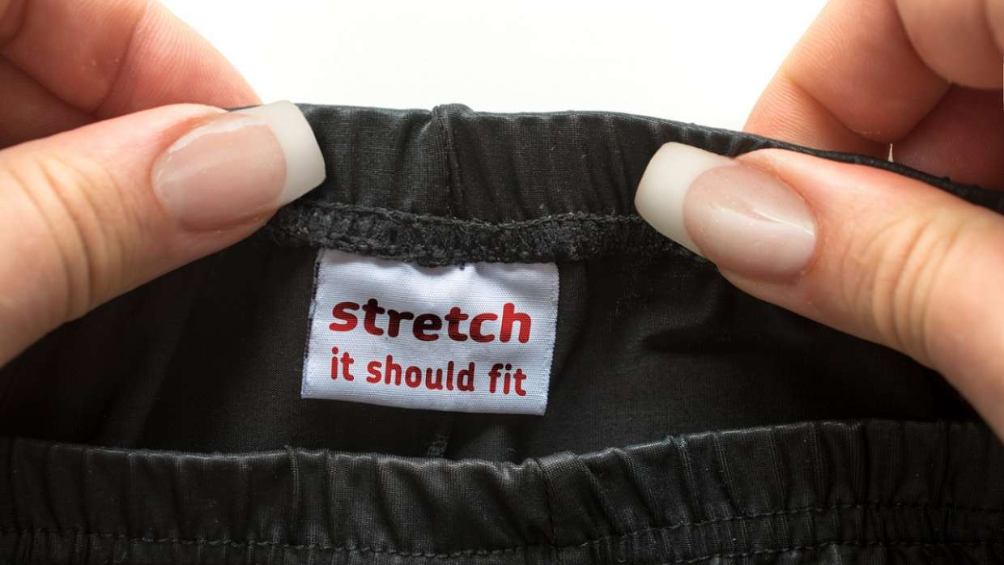

Slide 9
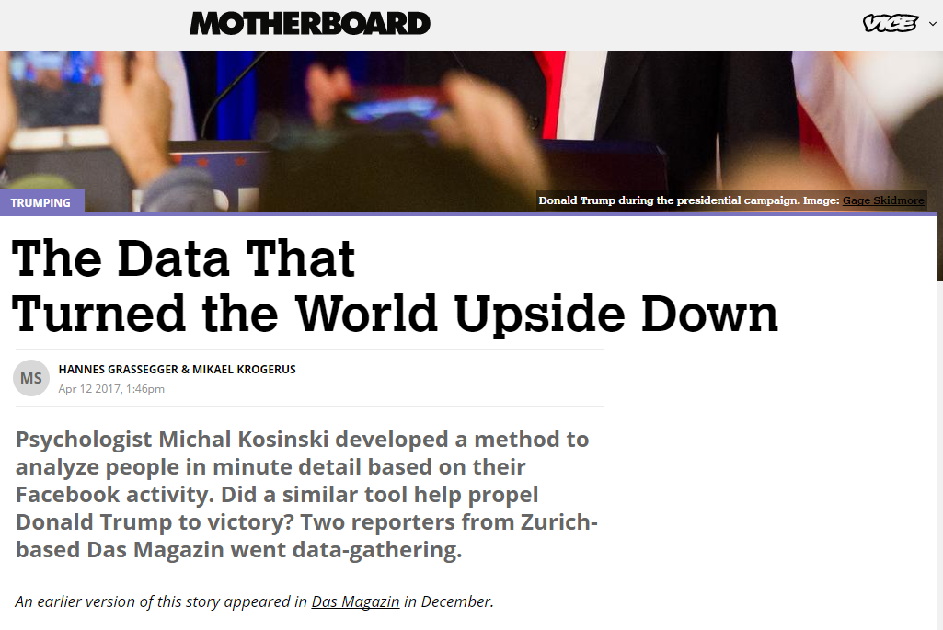

Slide 10
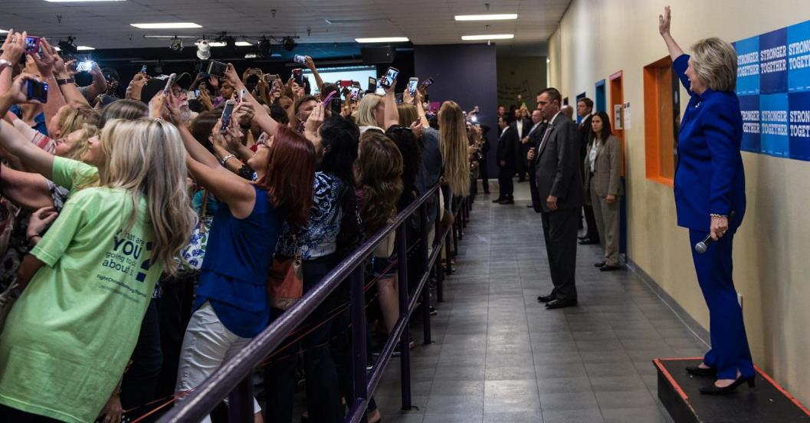
THROUGH THE “EYES OF THE SCREENS”
Notes:
Lets talk about Mobile.
I think it is fair to say that after Cinema or the invention of moving images, Mobile is the first real invention that has fundamentally altered human behavior in all aspects of the word. This picture that you see on screen was taken from one of recent Clinton/Trump debates.
Mobile is not just a communication or a media channel. In fact treating it just as that can never lead to a better understanding of the platform. Mobile is an extension of the self. It is the sight you see, the sound you hear- it is indeed the 7th sense in every possible way.

Slide 11
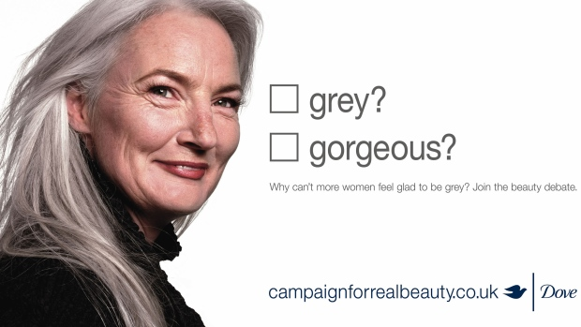

Slide 12
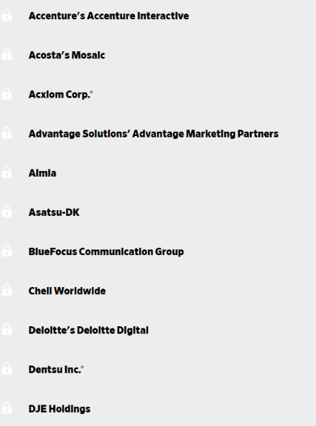
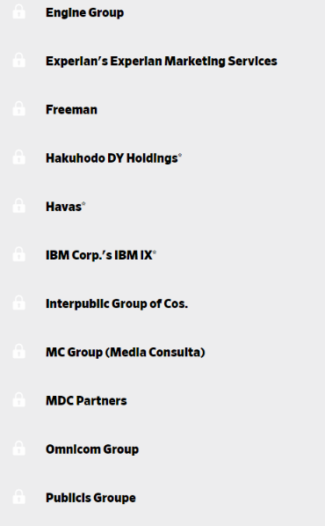
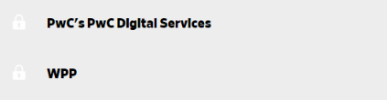


Slide 13
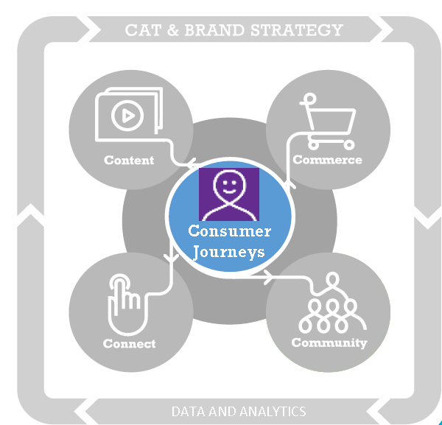
HOW WE DO IT AT UNILEVER

Slide 14
THANK YOU FOR YOUR TIME.

